Slide 1
MP/BME 710: Journal club
Magnetic Resonance Elastography of Liver:
Technique, Analysis, and Clinical Applications
Sudhakar K. Venkatesh, MD, Meng Yin, PhD, and Richard L. Ehman, MD
Grant Roberts
Department of Medical Physics

Slide 2
Outline
Introduction
Liver Fibrosis
Basic Principles of MRE
MRE Sequence
Post-processing (Production of Elastograms)
Clinical Applications
Conclusion

Slide 3
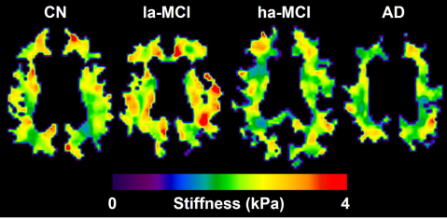
Introduction
Mechanical properties of tissues often change during disease
Tumor (hard) vs. benign lipoma (soft)
Muscle stiffness (muscular dystrophy)
Viscoelasticity brain parenchyma
Liver fibrosis
Palpation has been used for centuries
MRE allows quantitative analysis of mechanical properties
“Virtual palpation”
Murphy MC, Jones DT, Jack CR, et al. Regional brain stiffness changes across the Alzheimer’s disease spectrum. NeuroImage Clin 2016;10:283–290.
Notes:
Mechanical properties of tissues, specifically stiffness, provide valuable information about disease processes. For years, physicians have been using sense of touch (palpation) to aid in diagnosis by literally feeling the stiffness of organs, most markedly in differentiating malignant tumors (harder) and benign tumors (softer). However, there are other disease which change tissue stiffness that cannot be palpated non-invasively, such as stiffness of the brain in Alzheimer patients or liver fibrosis. MRE provides a way to non-invasively and quantitatively assess mechanical properties of tissues.

Slide 4
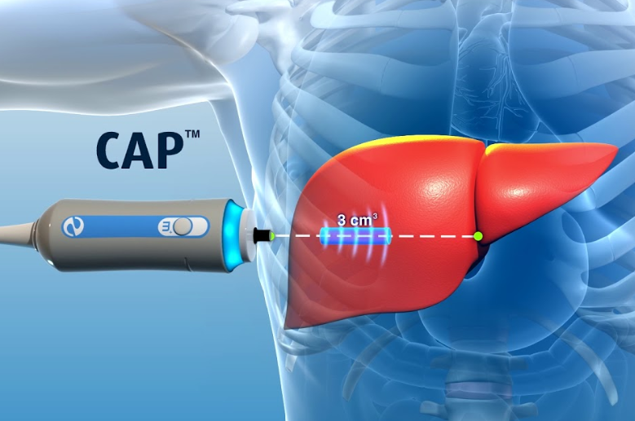
Liver Fibrosis
Caused by various diseases
Hepatitis A,B,C, alcoholism, portal vein thrombosis, NAFLD
Fibrosis is reversible at early stages
Diagnosing fibrosis
Percutaneous biopsy (gold standard)
Invasive, expensive, poor patient acceptance, risk of complication (~3%)
Samples prone to inter-observer variability and poor repeatability
Serum markers
Variable accuracies
Ultrasound Elastography (Fibroscan)
Successful, but limited to localized spot measurements
Obesity, ascites, bowel interposition may limit diagnostic accuracy
MR Elastography
Creates complete stiffness map of liver, more accurate than Fibroscan¹
Hepatic iron overload, breath-hold may limit diagnostic accuracy
https://www.youtube.com/watch?reload=9&v=TXxI4bB_CQY
1. Xiao H, Shi M, Xie Y, Chi X. Comparison of diagnostic accuracy of magnetic resonance elastography and Fibroscan for detecting liver fibrosis in chronic hepatitis B patients: A systematic review and meta-analysis. PLoS One 2017;12:1–14.
Notes:
Liver fibrosis can be caused by a number of diseases, such as Hepatitis A,B,C, alcoholism, portal vein thrombosis, non-fatty liver disease, and many other diseases. If left untreated, this will eventually lead to non-reversible chirrosis. But, if detected early enough, can be reversible.

Slide 5
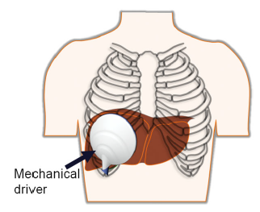
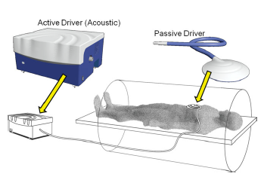
Basic Principles of MRE
Transverse waves are introduced by driver (20-200Hz)
Active pneumatic driver placed outside of MR room
Passive driver placed on patient
Shear waves (longitudinal) are produced
Wavelength dependent on shear modulus
Waves propagate rapidly in stiff tissue, slower in softer tissue

Slide 6
Basic Principles of MRE
Modified phase-contrast sequence
Sensitized motion to cyclic displacement from shear waves
Displacements on the order of microns
Spins accumulate phase along bipolar or 1st order gradient
Motion encoding gradients (MEG)
Synchronized to driver frequency
Can be placed in any dimension (x,y,z)
Venkatesh SK, Yin M, Ehman RL. Magnetic Resonance Elastography of Liver: Technique, Analysis, and Clinical Applications. 2013;37:544–555.

Slide 7
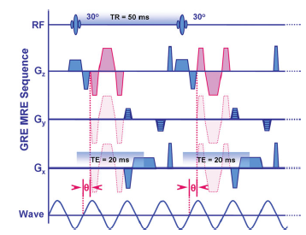
Basic Principles of MRE
Basic Liver Sequence
Short TR (50ms), short TE (20ms), and low flip angle (<30˚)
Requires less than a minute of acquisition time
Uses fast sequences (EPI, GRE, or FSE)
Only acquires 2-4 slices
Parallel imaging (x2)
256 x 64 matrix
Phase offsets = 4
Breath-hold (15 s)

Slide 8
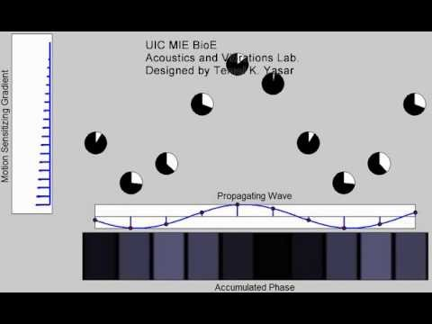
Basic Principles of MRE

Slide 9
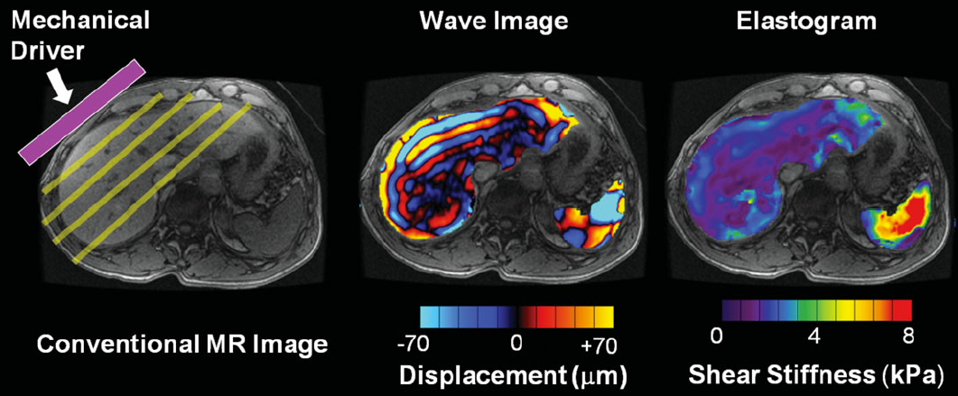
Post-processing
How do we obtain pressure information from wave images?
Local frequency estimation
Inversion algorithm utilizing equations of motion to solve for shear modulus
Without assumptions
Inversion matrix = rank-4 tensor with 21 independent complex quantities
Simplifying assumptions = incompressible, isotropic
Inversion matrix reduced to 2 independent quantities
?

Slide 10
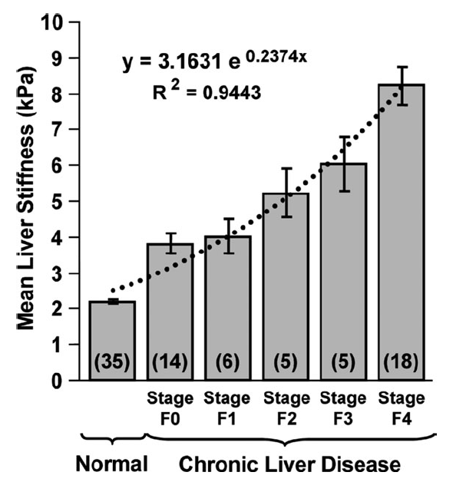
Applying MRE to Liver
Normal liver parenchyma has shear stiffness < 3 kPa
Liver stiffness increases as histologic fibrosis increases
sfsf

Slide 11
Clinical Applications

Slide 12
Clinical Applications

Slide 13
Conclusion
Benefits
Quick scan
Can be easily incorporated into liver protocols
Dixon/IDEAL (measure fat)
Diffusion Weighted (lesions, fibrosis)
MRE (visualizing varices
4D flow (flow in varices and portal hepatic system)
Reproducible across vendors and field strengths
Downsides
Lower resolution
Require breath-hold

Slide 14
References
Venkatesh SK, Yin M, Ehman RL. Magnetic Resonance Elastography of Liver: Technique, Analysis, and Clinical Applications. 2013;37:544–555
Xiao H, Shi M, Xie Y, Chi X. Comparison of diagnostic accuracy of magnetic resonance elastography and Fibroscan for detecting liver fibrosis in chronic hepatitis B patients: A systematic review and meta-analysis. PLoS One 2017;12:1–14.
Murphy MC, Jones DT, Jack CR, et al. Regional brain stiffness changes across the Alzheimer’s disease spectrum. NeuroImage Clin 2016;10:283–290.

Slide 15
Questions
Questions?

